Slide 1
My Assignment on the internet speed test
This will cover:
The average internet speed of the group
How this compares to the national average
Why could the results be what they are
Was this a good experiment and how it can be changed

Slide 2
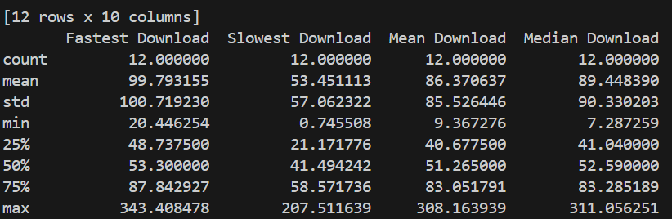
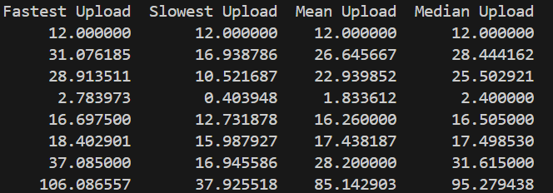
The Average internet speed of the group
After doing work on my own internet speeds and then comparing those speeds with the groups.
The groups average Download speed is 86.37mbps. The groups average upload speed is 26.64mbps.
The groups Download speeds
The groups Upload speeds

Slide 3
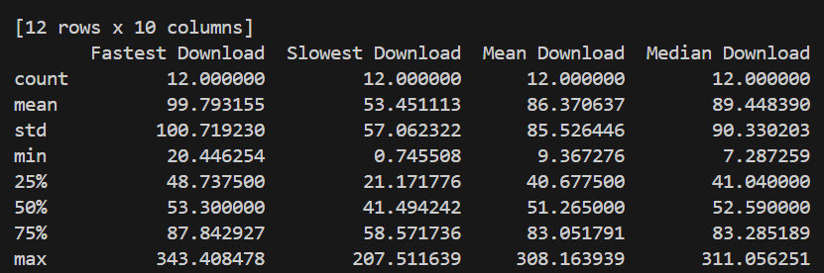
The average internet speed of the group
And after calculating the groups average median download and upload speeds.
The median download speed for the group is 89.44mbps. The median upload speed for the group is 28.44mbps.
The groups download speed
The groups upload speed

Slide 4

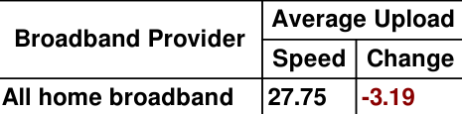
How this compares to the national average
Getting my information from World Population Review and Broadband, I have found the nations average download and upload speeds.
The national mean download speed is 110.99mbps which is a 24.62mbps or a 28.5% decrease meaning we are below the national average for our mean and a 21.55mbps or a 24.1% decrease for our median.
The national mean upload speed is 27.75 which is a 1.11mbps or a 4.2% decrease meaning we are below the national average for our mean. However, we are above the national average on median upload with a 0.69mbps or a 2.5% increase.

Slide 5

Why are the results be what they are?
There are different factors to why our results are what they are and why all of us have different speeds and results. Here are 3 examples.

Slide 6
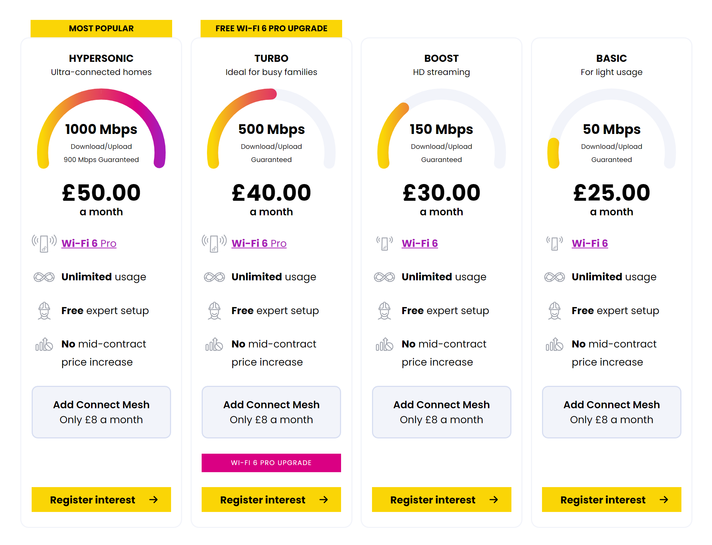
Why are the results be what they are?
The first factor is broadband packages.
Broadband can vary based on what people are paying for. For example, shown by the image, there are different packages showing better speeds for more money.
Some people may be able to afford the most expensive option, and some cannot and have to resort to the cheaper option.

Slide 7
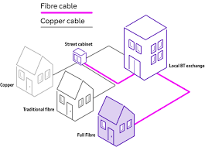
Why are the results be what they are?
The second factor is location.
There can be two people who pay for the same package but due to location, someone who lives further away from the exchange may receive a poorer connection compared to someone living relatively close.
This is due to more copper cables being used to reach the house if copper cables are still being used.

Slide 8
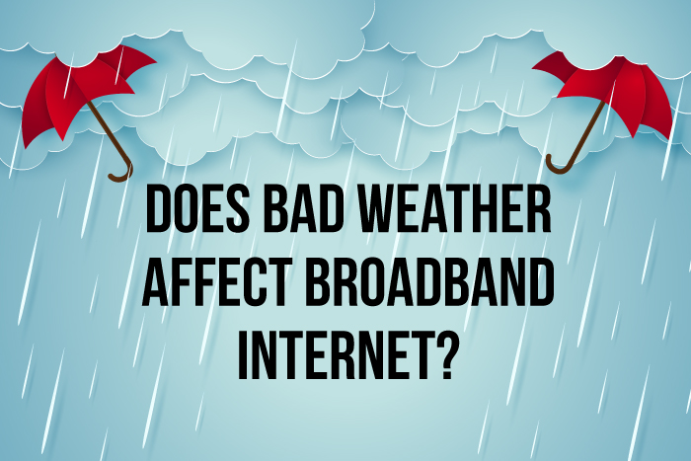
Why are the results be what they are?
The third and final factor is weather conditions.
Weather conditions such as rain can affect broadband connections due to cables and equipment being exposed to moisture which can lead to disruptions in connectivity.
Water droplets can also affect the broadband as they can be absorbed and scatter the signal, leading to a reduced strength and range.

Slide 9
Was this a good experiment? Why? Why Not? What would you change?
As a conclusion, I don’t believe this was a good experiment. My reasoning behind this is purely due to the factors I showed and explained about earlier.
For example, it is currently autumn coming into winter, so we are expecting a lot of bad weather, especially Storm Bert currently happening right now. The national average could have been recorded during the summer when the weather was more desirable for the broadband. If we had done this experiment in the summer, we may have received better results.
Another reason is that some broadband providers can perform better than their competitors despite prices being exactly the same or similar. This is due to the amount of capacity that an ISP (Internet Service Provider) has installed in its network. What we could have done is grouped with people who have the same broadband provider and compared for a more accurate result.

